Slide 1
II. Linear Independence
Definition and Examples

Slide 2

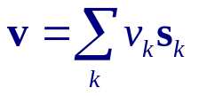


II.1. Definition and Examples
Lemma 1.1:
Let S be a subset of vector space V, then ∀ v ∈ V,
Span S = Span( S ∪ {v} ) iff v∈ Span S
Proof ⇒ (only if) :
Span( S ∪ {v} ) → v∈ Span( S ∪ {v} )
∴ Span S = Span( S ∪ {v} ) → v∈ Span S
Proof ⇐ (if) :
v∈ Span S →
→
QED

Slide 3
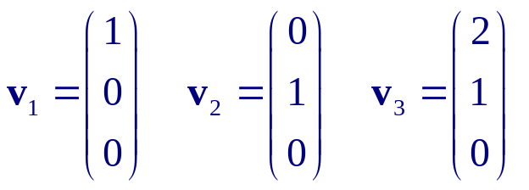


Example 1.2:
Let
Then
because
Definition 1.3: Linear Independence (L.I.)
A subset of a vector space is linearly independent (L.I.) if none of its elements is a linear combination of the others.
Otherwise, it is linearly dependent (L.D.).
Note: This is seldom use in practice.

Slide 4

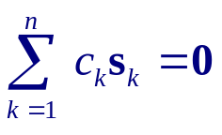

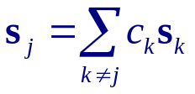
Lemma 1.4: Practical Test for L.I.
is L.I. iff
→
Proof ⇒ :
If S is L.I., one cannot write
∀ j.
Hence,
can only be satisfied by
Proof ⇐ (By negation) :
If S is not L.I., ∃ j s.t.
i.e.,
can be satisfied by c_{j} = −1 ≠ 0.
Negation of this completes the proof.

Slide 5

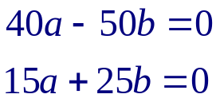
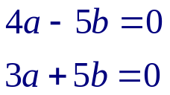
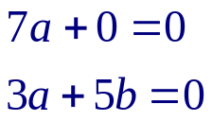
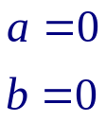

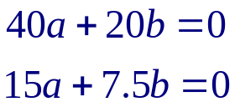
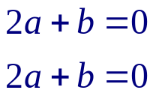

Example 1.5: 2-D Row vectors
{ (40 15), (−50 25) } is L.I.
Proof:
Let
→
→
→
→
{ (40 15), (20 7.5) } is L.D.
Proof:
Let
→
→
→

Slide 6

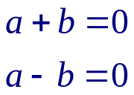
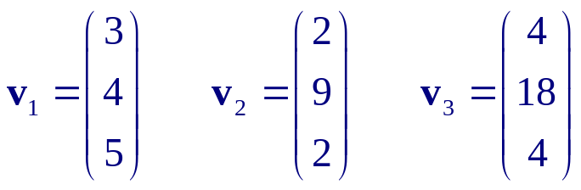
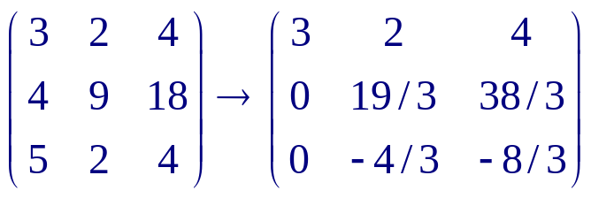
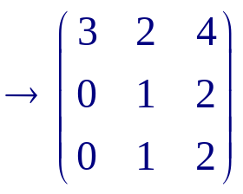
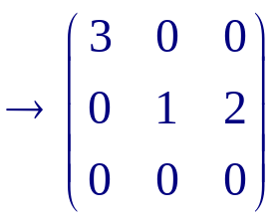

Example 1.7: ₂
{ 1+x , 1−x } is L.I.
Proof:
Let
→
→
Example 1.8: ³
Let
then S = { v₁ ,v₂ , v₃ } is L.D.
Proof:
→

Slide 7


Example 1.10: Empty subset is L.I.
Example 1.11: Any subset S containing 0 is L.D.
Proof:
∀ a ∈ 
Alternative proof 1:
Alternative proof 2: 0 is a linear combination of the empty set ∅ ∈ S.
Theorem 1.12:
Any finite subset S of a vector space V has a L.I. subset U with the same span as S.
Proof:
If S is L.I., setting U = S completes the proof.
If S is not L.I., ∃ s_{k} s.t. s_{k} = Σ_{j≠k} c_{j} s_{j} .
By Lemma 1.1, span S₁ = span S, where S₁ = S − {s_{k}} .
If S₁ is L.I., the proof is complete.
Else, repeat the extraction until L.I. is achieved. QED.

Slide 8
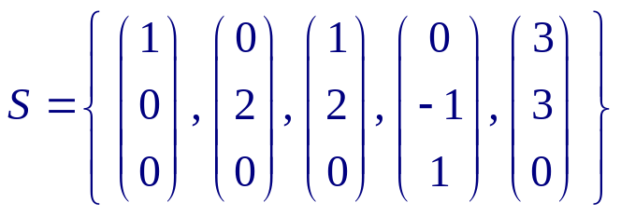
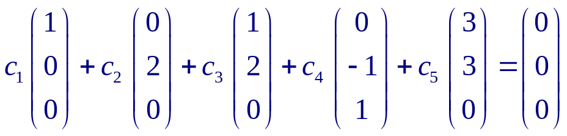
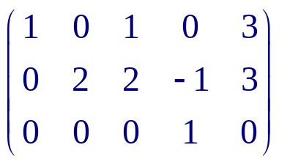
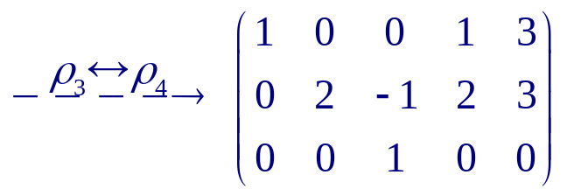
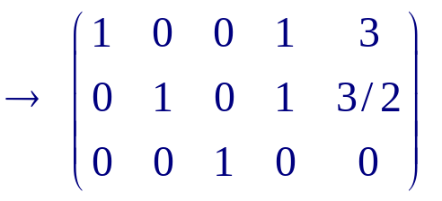
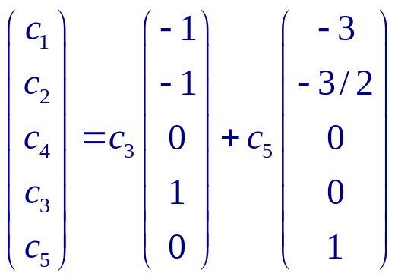
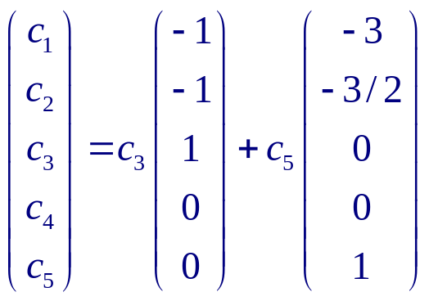
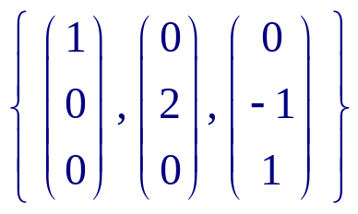
Example 1.13
spans ³
The independence test equation
gives
∴
or
→
is L.I. & spans ³

Slide 9
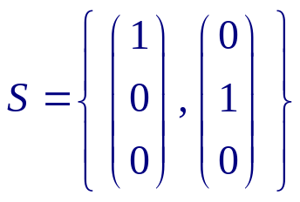
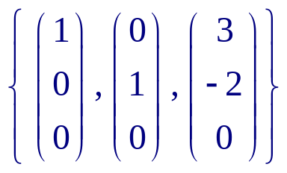
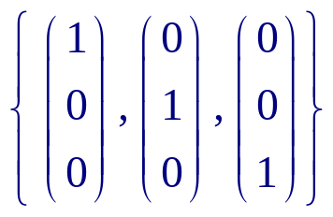
Lemma 1.14:
Any subset of a L.I. set is also L.I. ( L.I. is preserved by the subset operation.)
Any superset of a L.D. set is also L.D. ( L.D. is preserved by the superset operation.)
 | S₁ ⊂ S | S₂ ⊃ S
S is L.I. | S₁ is L.I. | --
S is L.D. | -- | S₂ is L.D.
Proof: Trivial.
Subset of a L.D. set can either be L.I. or L.D. (see Example 1.13)
Superset of a L.I. set can either be L.I. or L.D. (see Example 1.15)
Example 15:
is L.D.
is L.I.

Slide 10
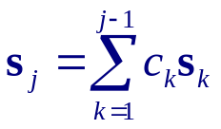
Lemma 1.16:
Let S be a L.I. subset of vector space V , then ∀ v ∈ V & v ∉ S,
S ∪ {v} is L.D. iff v ∈ span S.
Proof ⇐ :
By Definition 1.13, v ∈ span S & v ∉ S ⇒ S ∪ {v} is L.D.
Proof ⇒ :
S is L.I. ⇒ no s_{k} is a linear combination of the other s_{j}’s .
S ∪ {v} is L.D. ⇒ v must be a linear combination of the s_{j}’s. QED
Corollary 1.17:
A subset S = {s_{k} | k = 1,…,n } of V is L.D. iff
for some j ≤ n
Proof: By construction.
Lemma 1.16a: Negation of Lemma 1.16
Let S be a L.I. subset of vector space V , then ∀ v ∈ V & v ∉ S,
S ∪ {v} is L.I. iff v ∉ span S.

Slide 11
Summary
is L.I. ⇔
→
Let S be L.I., then
{ S , v } is L.I. ⇔ v ∉ span S
The smallest set that spans V must be L.I.

Slide 12
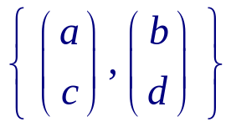
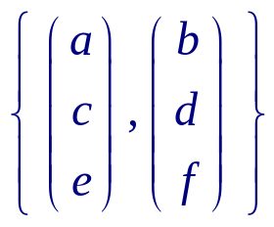
Exercises 2.II.1.
1. Prove that each set { f, g } is linearly independent in the vector space of all functions from ⁺ to .
(a) f(x) = x and g(x) = 1/x
(b) f(x) = cos(x) and g(x) = sin(x)
(c) f(x) = e^{x} and g(x) = ln(x)
2. With a little calculation we can get formulas to determine whether or not a set of vectors is linearly independent.
(a) Show that this subset of ²,
is linearly independent if and only if ad− bc ≠ 0.
(b) When is this subset of ³,
linearly independent?

Slide 13
3. Consider the set of functions from the open interval (−1,1) to .
(a) Show that this set is a vector space under the usual operations.
(b) Recall the formula for the sum of an infinite geometric series:
1 + x + x² + … = 1 / (1−x) for all x ∈ (−1,1).
Why does this not express a dependence inside of the set
{ g(x) = 1 / (1−x) , f₁(x) = x, f₂(x) = x², … }
in the vector space that we are considering?
(Hint. Review the definition of linear combination.)
(c) Show that the set in the prior item is linearly independent.
This shows that some vector spaces exist with linearly independent subsets that are infinite.

